Slide 1

If a Butterfly’s flapping of wings can create a tornado, it can also prevent one.
Edward Lorenz

Slide 2
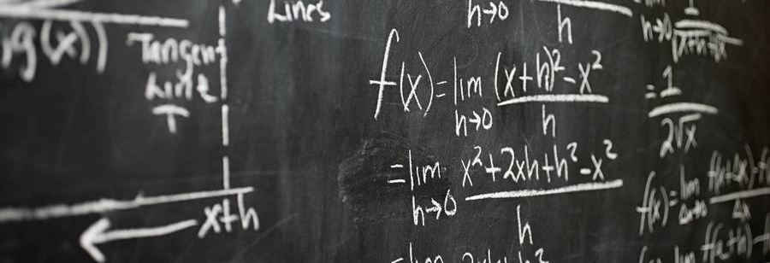
Lorenz Equations
Ekansh Somani Gali Sunny Narla Karthikeya Shanmukhi Ganesh Sai Zeeshan Snehil Bhagat

Slide 3
Content
Introduction
Introducing Lorentz equation, and some of its applications.
Equation and Chaos.
More details about the equation. Its uses in various environments. And the predictability of Weather. And Chaos.
Numerical Methods
Brief details about the used methods and code.
Observation
Summary
The graphs, their intricacies, and the conclusions drawn from them.
The overall learnings, and conclusions drawn from the project.

Slide 4
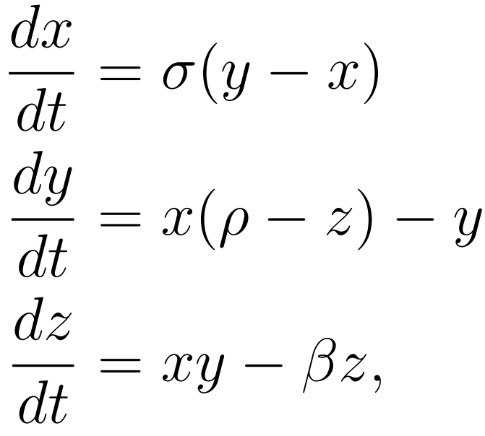
Introduction
Lorenz Equations are a set of ordinary differential equations which gives chaotic solutions for certain parameter values and initial conditions.
The equations have three variable parameters along with initial conditions.
They were first developed and studied by Edward Lorenz in 1963.

Slide 5

Equations, Predictions, And Chaos

Slide 6
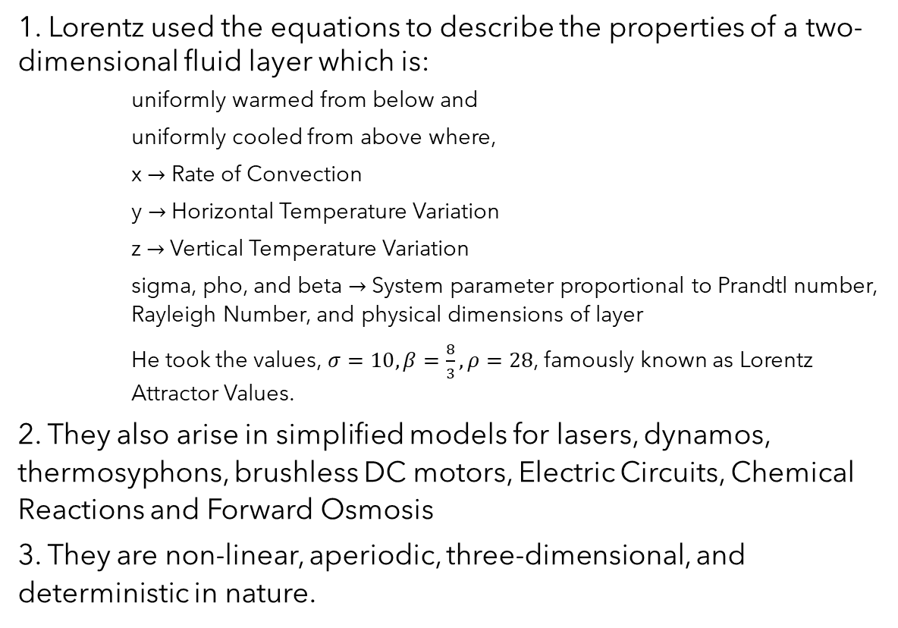
The Equations
1. Lorentz used the equations to describe the properties of a two-dimensional fluid layer which is:
uniformly warmed from below and
uniformly cooled from above where,
x $→$ Rate of Convection
y $→$ Horizontal Temperature Variation
z $→$ Vertical Temperature Variation
sigma, pho, and beta $→$System parameter proportional to Prandtl number, Rayleigh Number, and physical dimensions of layer
He took the values, $σ=10, β=\frac{8}{3}, ρ=28$, famously known as Lorentz Attractor Values.
2. They also arise in simplified models for lasers, dynamos, thermosyphons, brushless DC motors, Electric Circuits, Chemical Reactions and Forward Osmosis
3. They are non-linear, aperiodic, three-dimensional, and deterministic in nature.
Notes:
Lorenz used it for the fluid layer, but it can also be used for weather. X can represent temperature, y displays humidity and z is pressure.

Slide 7
Prediction And Chaos
Lorentz equations diverge away over time for very small changes in initial values.
You need to measure the initial value to a high degree of precision and accuracy to be able to predict the weather for a few days.
This diversion is called Chaos.

Slide 8
Numerical Methods
Methods of Iterative Guesses

Slide 9
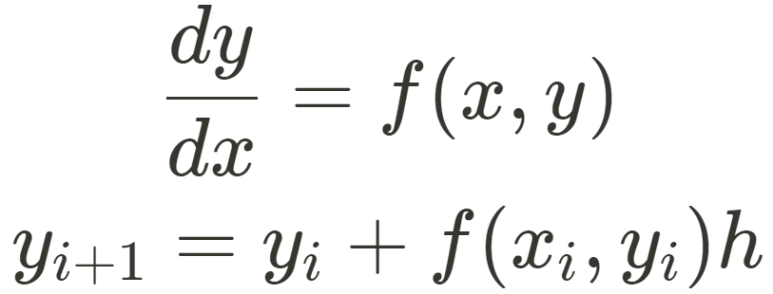
Euler Method
Extrapolates linearly over an arbitrary step size h using the slope (first derivative of y).

Slide 10
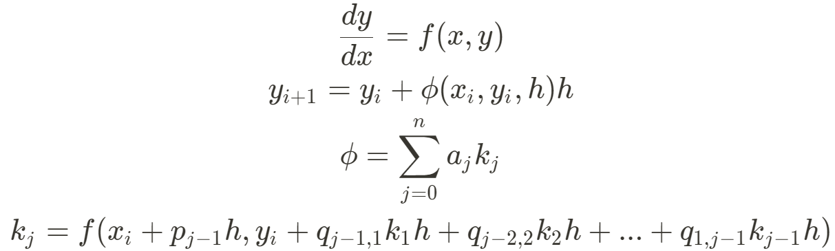
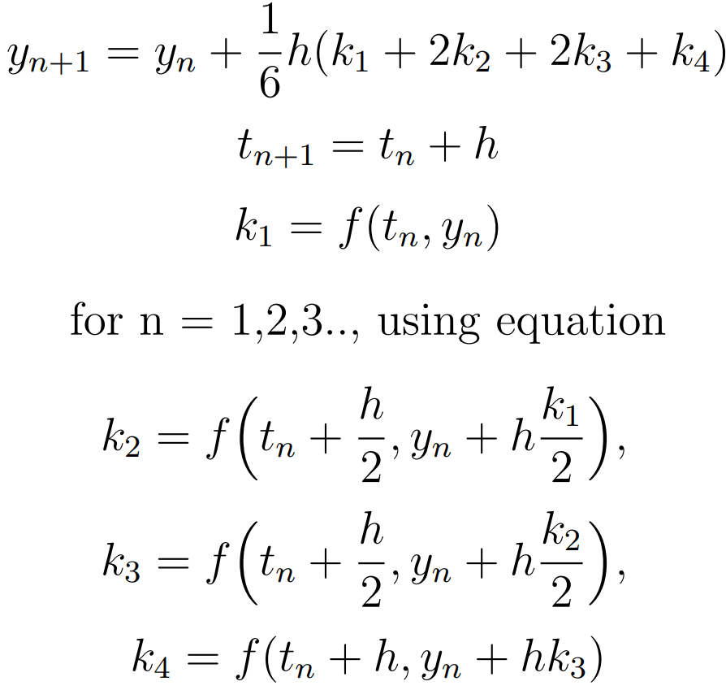
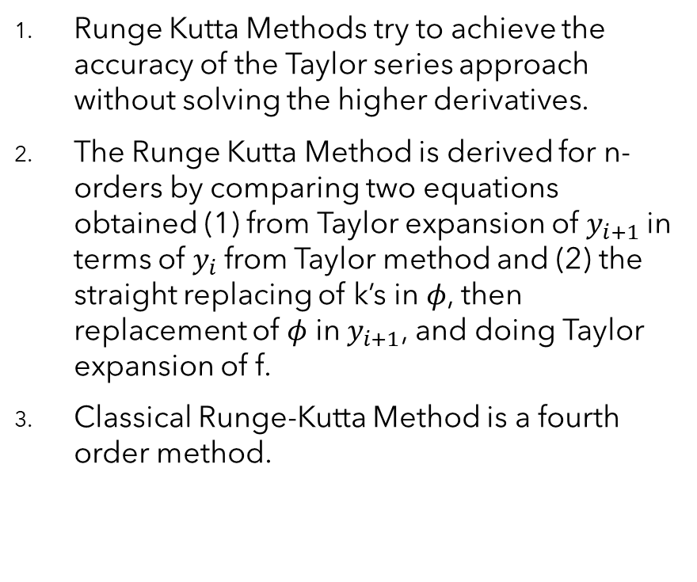
Runge-Kutta Method
Runge Kutta Methods try to achieve the accuracy of the Taylor series approach without solving the higher derivatives.
The Runge Kutta Method is derived for n-orders by comparing two equations obtained (1) from Taylor expansion of $y_{i+1}$in terms of $y_{i}$from Taylor method and (2) the straight replacing of k’s in $φ$, then replacement of $φ$ in $y_{i+1}$, and doing Taylor expansion of f.
Classical Runge-Kutta Method is a fourth order method.

Slide 11
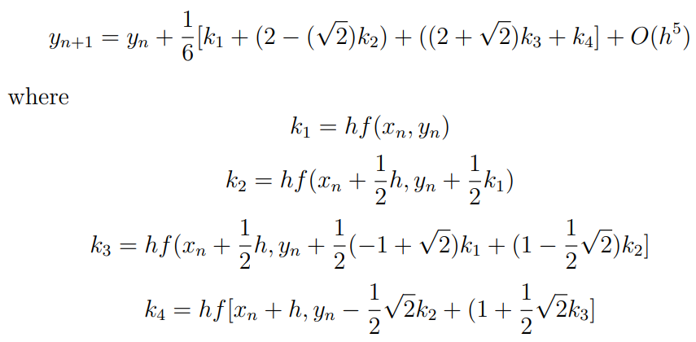
Runge-Kutta Gil Method
The Runge-Kutta-Gill method is a variant of the classical Runge-Kutta method being used for approximating the solution of the differential equation given by, Y ′ (t) = f(t, Y )

Slide 12
Observations

Slide 13
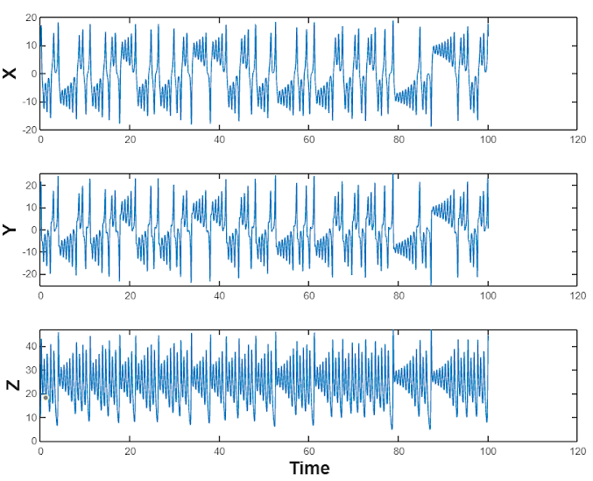
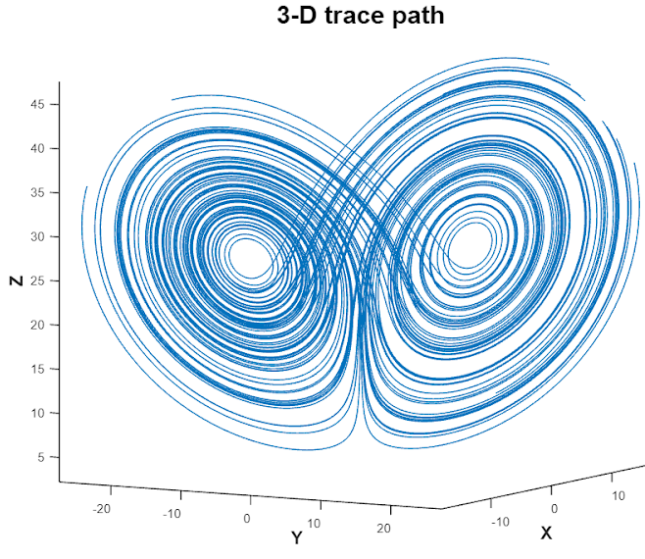
Euler Method

Slide 14
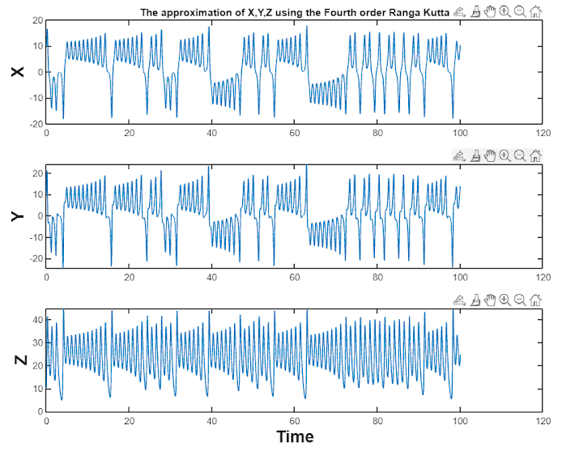
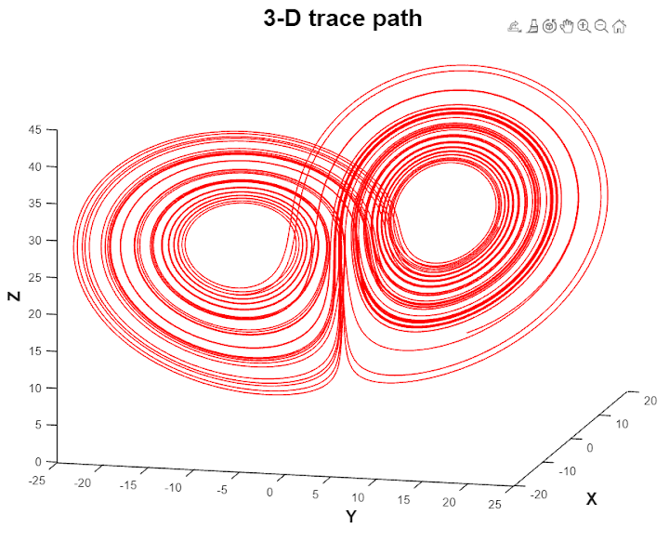
Results from Runge Kutta Method

Slide 15
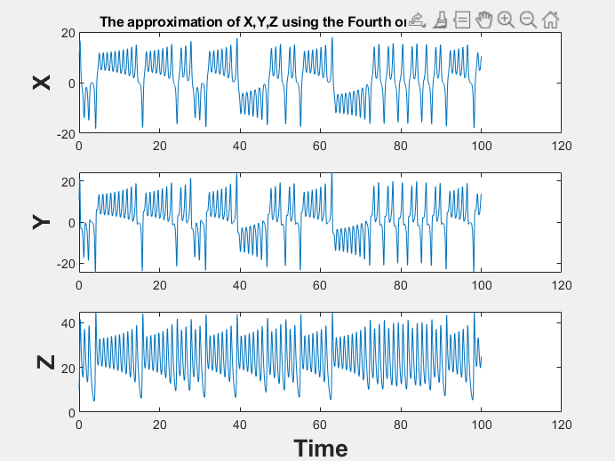
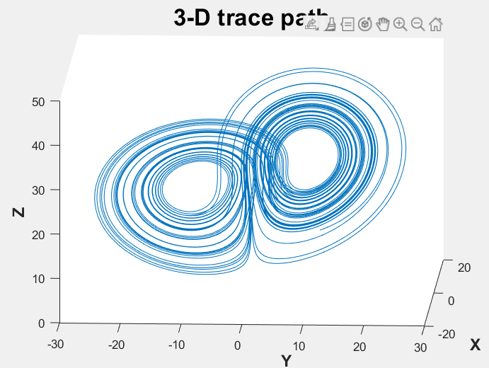
Runge-Kutta Gill Method

Slide 16
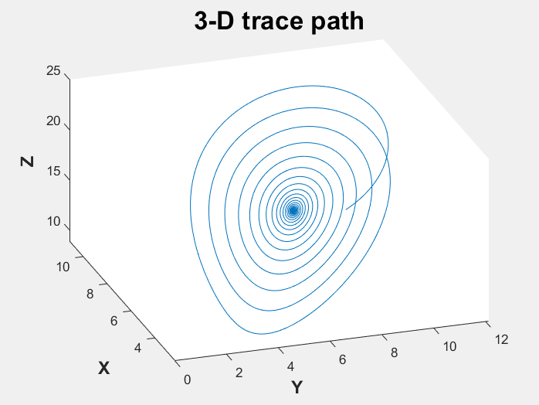
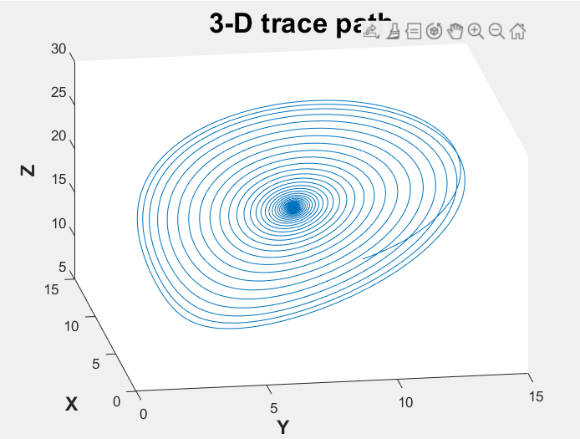
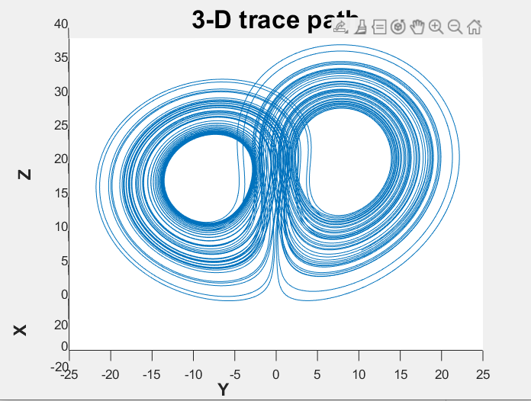



Lorenz System for distinct values of $ρ$
$$σ=10$$
$$ρ=17$$
$$β=8/3$$
$$σ=10$$
$$ρ=20$$
$$β=8/3$$
$$σ=10$$
$$ρ=25$$
$$β=8/3$$
Notes:
Critical Points become repulsive in nature for rho > 24.74. Thus, the graph shows two different lobes.

Slide 17
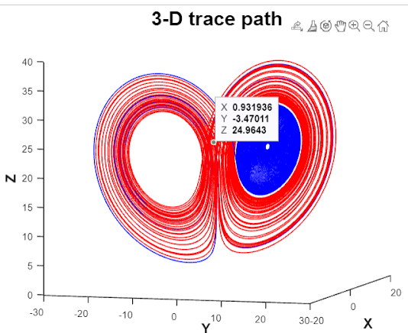
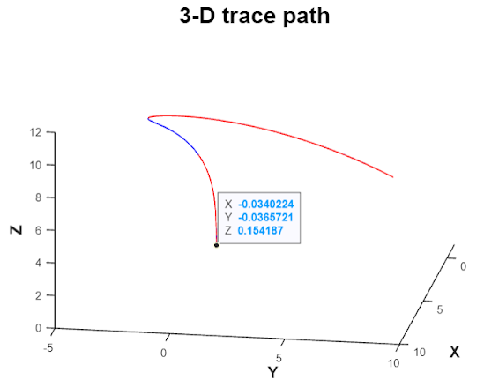
Sensitivity
Convergence
Notes:
For a small change in the initial value from [10,10,10] to [10.01 , 10.01,10.1]. the maximum absolute error obtained is 34. If we take the Rho< 1 then the solution will converge to zero.

Slide 18
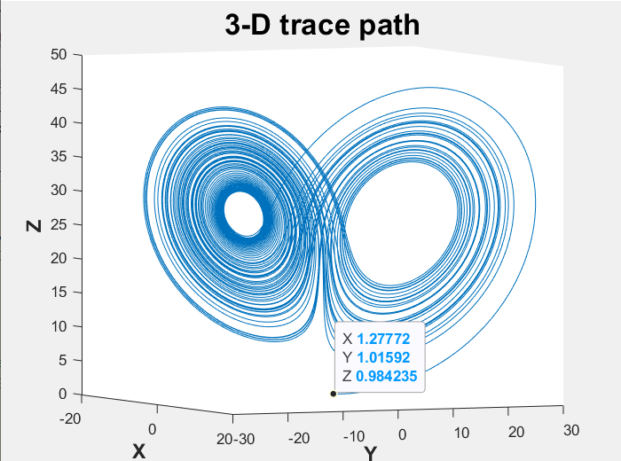
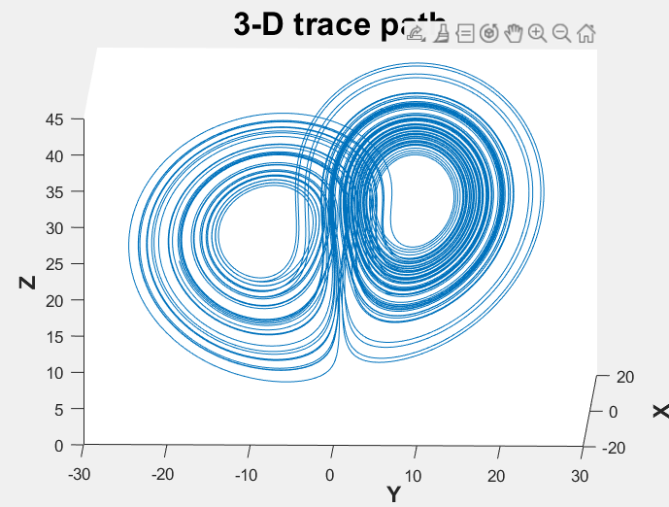
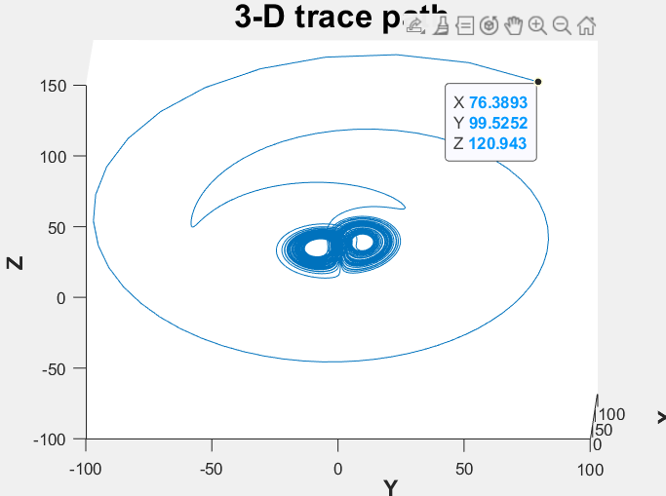
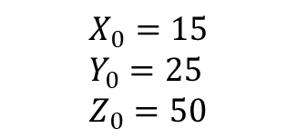
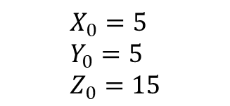
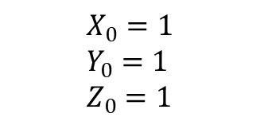
Different Initial Conditions
$$X_{0}=1 \\ Y_{0}=1 \\ Z_{0}=1$$
$$X_{0}=5 \\ Y_{0}=5 \\ Z_{0}=15$$
$$X_{0}=15 \\ Y_{0}=25 \\ Z_{0}=50$$
Notes:
The main shape retains.

Slide 19




Summary
Lorenz equations hide within themselves a butterfly like structure, which reveals itself when the $ρ$is high enough for the graph to not collapse to the two critical points.
For small changes in the initial values, the resultant graphs trace out completely different paths eventually.
In fine, the numerical methods can be used to solve the Lorenz Equation.
The accuracy of the solution remains in doubt without verification from real world data.

Slide 20

Thank you
Zeeshan, Ganesh, Sunny, Karthikeya, and Ekansh.

